Slide 1
GreenBox HL
Solar powered DC-to-DC Home Lighting
Omega Natural Polarity Pvt Ltd
Notes:
This presentation demonstrates the new capabilities of PowerPoint and it is best viewed in Slide Show. These slides are designed to give you great ideas for the presentations you’ll create in PowerPoint 2011!
For more sample templates, click the File menu, and then click New From Template. Under Templates, click Presentations.

Slide 2
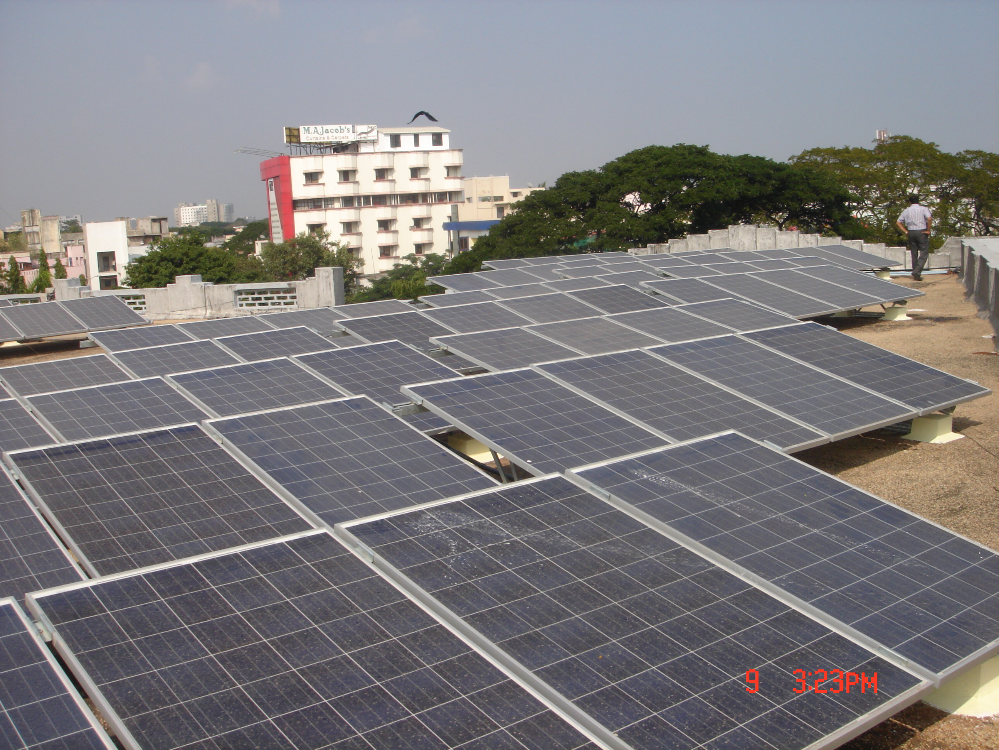
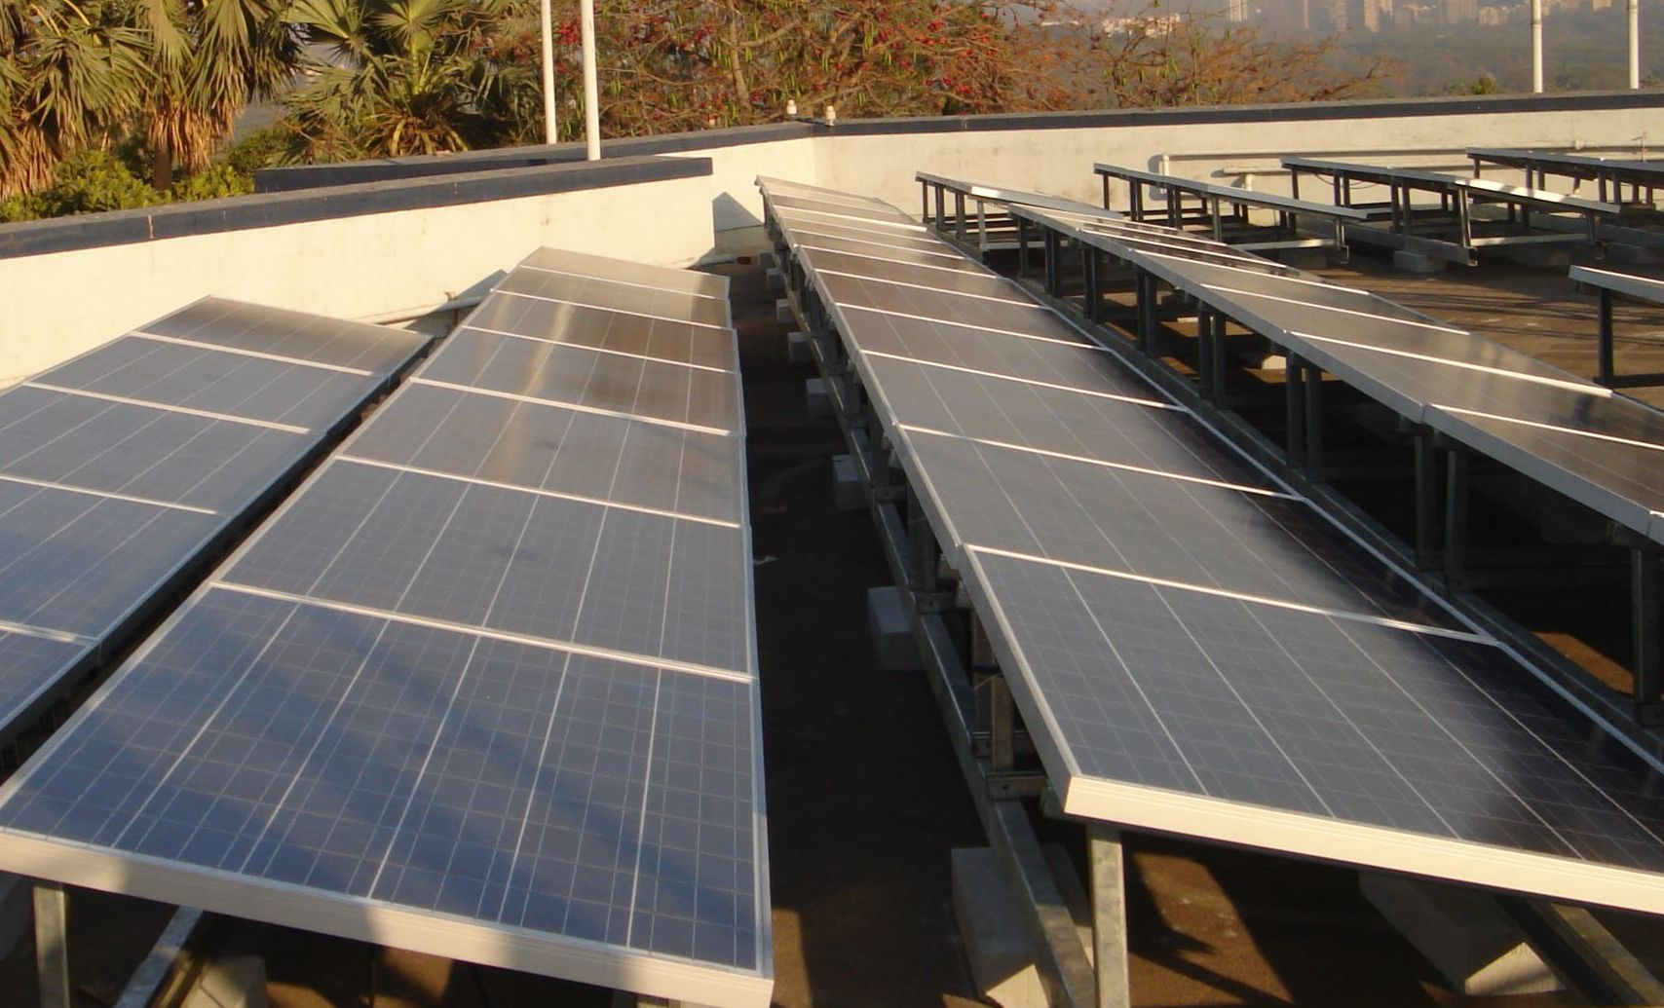
About Omega Natural Polarity (ONP)
ONP is mainly into Renewable energy and energy saving verticals with innovative technology, products and services.
We constantly engineer, design and adopt better technology in renewable energy vertical to promote clean energy. We transfer learning as a complete package & services to our clients as “EPCM” “Engineering, Procurement, Commission & Management”.

Slide 3
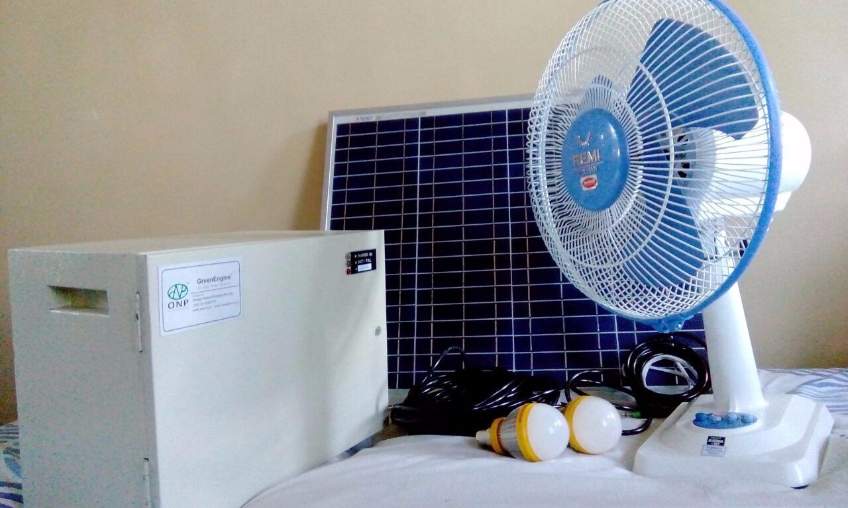
About GreenBox HL
Supports DC utilities like:
LED bulbs,
Fans,
TV,
Mobile charging
Its one of the flag ship product of our company. This product is mostly applicable for markets like rural, camps and locations disconnected rom grid.
Its based on DC-to-DC technology. Means this power is powered by Solar panels and out is also DC power.

Slide 4
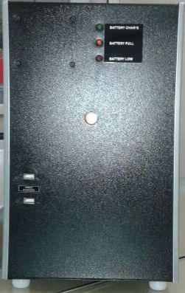
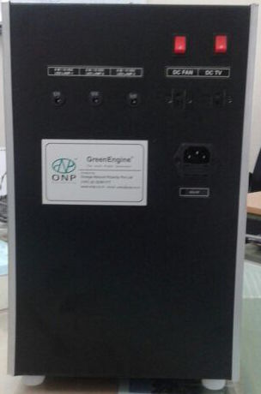
GreenBox HL Specs & Images
Front side
Back side
Specifications:
SPV 50Wp / 100Wp
Battery SMF / LFP
20AH & 40AH
5W LED bulbs 3no.s
DC fan 10W
DC TV 20W

Slide 5
Why ONP?
ONP is formed by an award winning & visionary technocrats.
ONP has certified engineers for onsite and remote support.
ONP partners with Proinso, CCL, Soleus. “German engineering”.
ONP Gets design engineering support from German team.
ONP German partner completes 2 GigaWatt end of 2013.
ONP manufactures Inverter/Controller unit for GreenBox.
ONP has presence in Maharashtra, TN, Karnataka, and AP.
ONP products are tested in our factory & QC centers.

Slide 6





Thank you
What’s Your Message?
Omega Natural Polarity Pvt Ltd
www.onp.co.in / 022 3226 1177 / sales@onp.co.in

